Slide 1
Transaction Academy
A open source web application to help disabled students search colleges, jobs, job skills, etc

Slide 2
Team
BHAVAZ AKULA
GOWTHAM VARMA VEGESNA
KRANTHI KIRAN REDDY VANGA

Slide 3
Introduction
You’re graduating high school and have to go through a case manager to match you with college and job training opportunities. This is reality for high school students with disabilities. Is it any wonder only 18.7 percent of persons with a disability are employed compared to 65.7 percent of those without a disability?
The Transition Academy fills this void by serving as a one-stop shop resource hub that provides an online listing of college, job, employment training and life skills programs for high school students with disabilities. Just like KC SourceLink serves as a resource hub for entrepreneurs and Show Me KC Schools helps families explore school options in KC Public Schools boundaries, The Transition Academy will serve as a post-secondary navigation tool to help families research and explore college and career opportunities so these students can seamlessly transition into colleges and the workforce after high school.

Slide 4
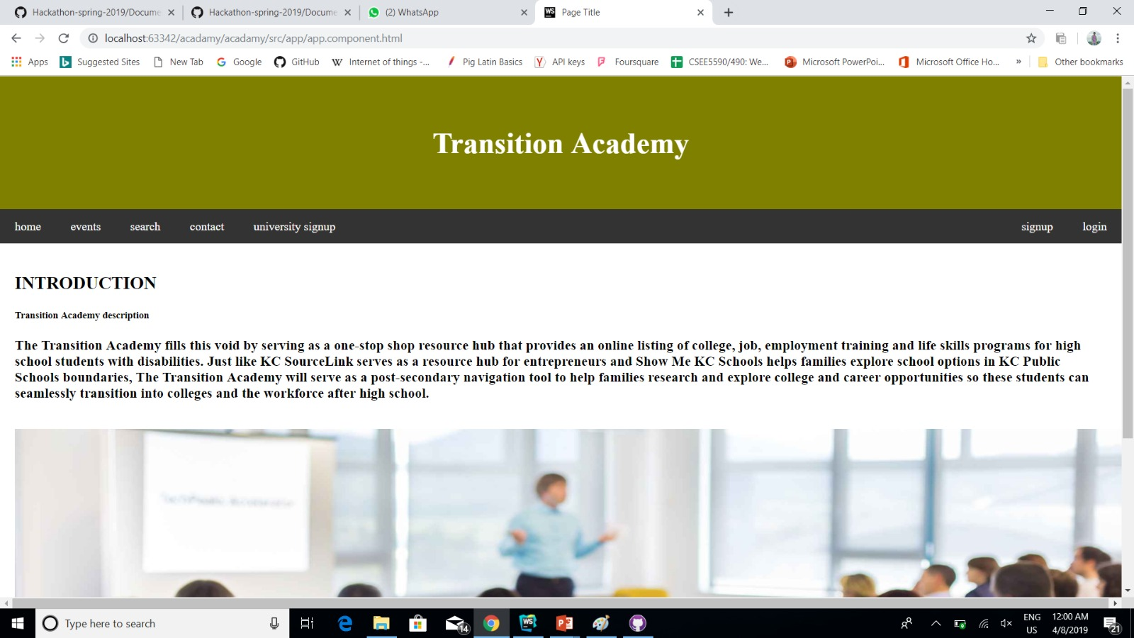
HOME PAGE

Slide 5
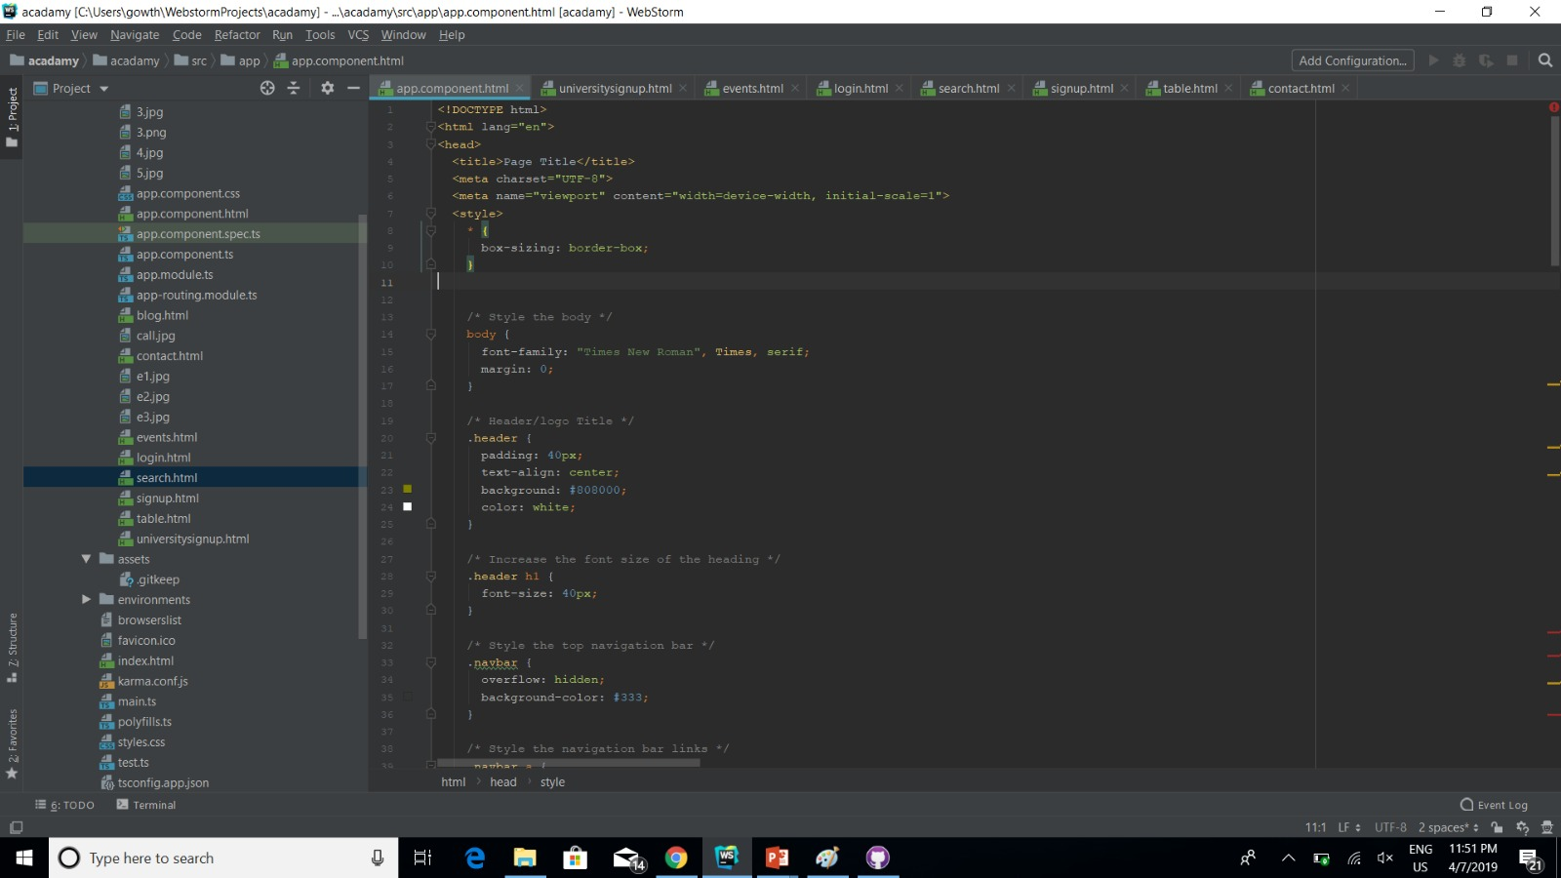
Code for home page

Slide 6
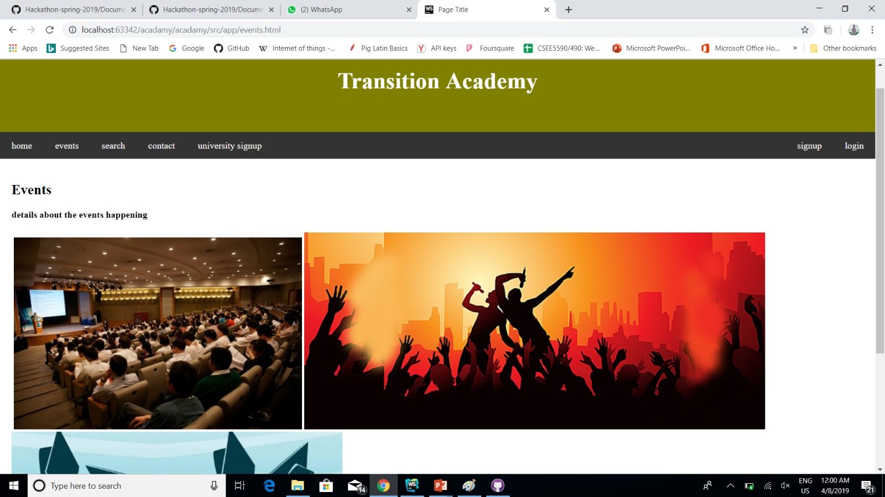
Events

Slide 7
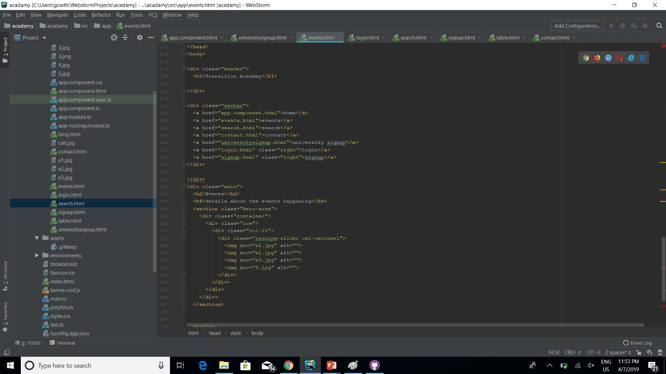
Code for Events page

Slide 8
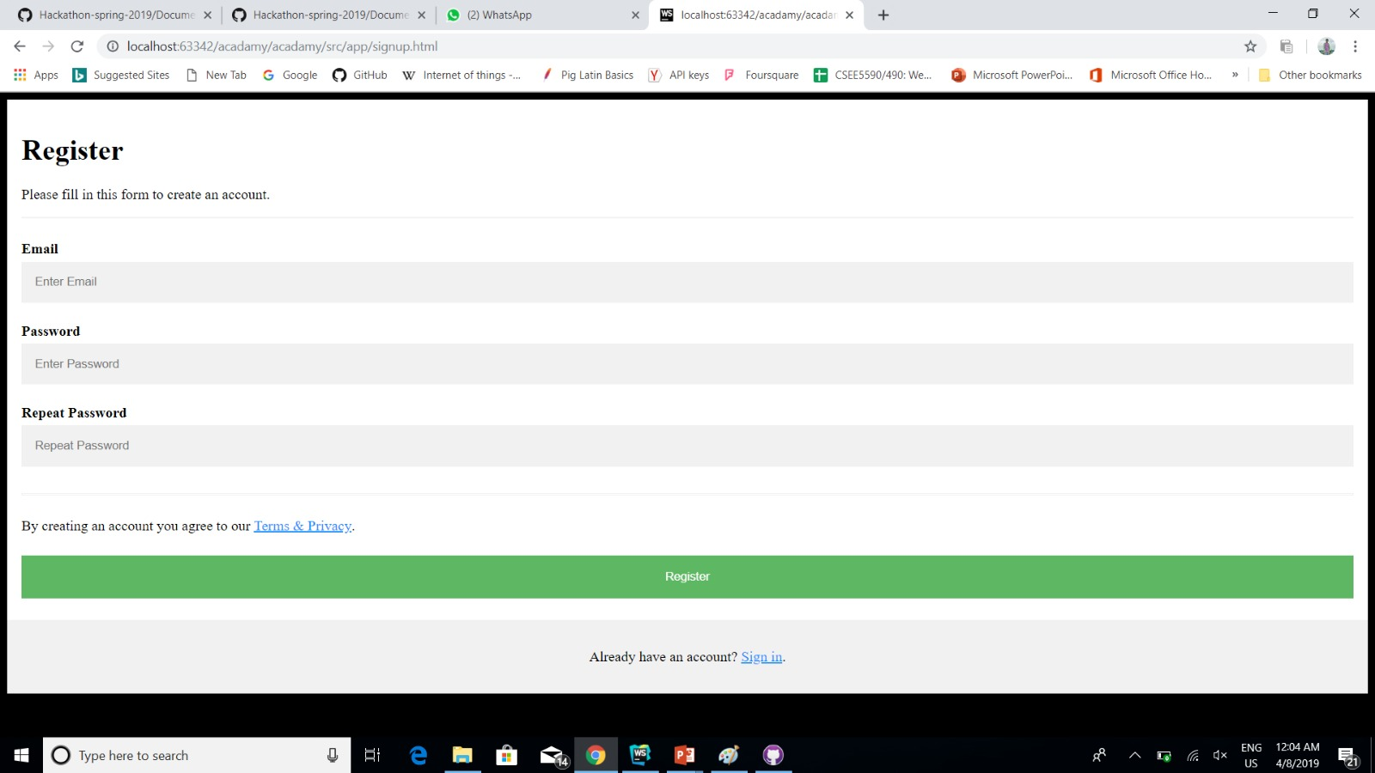
Registration page

Slide 9
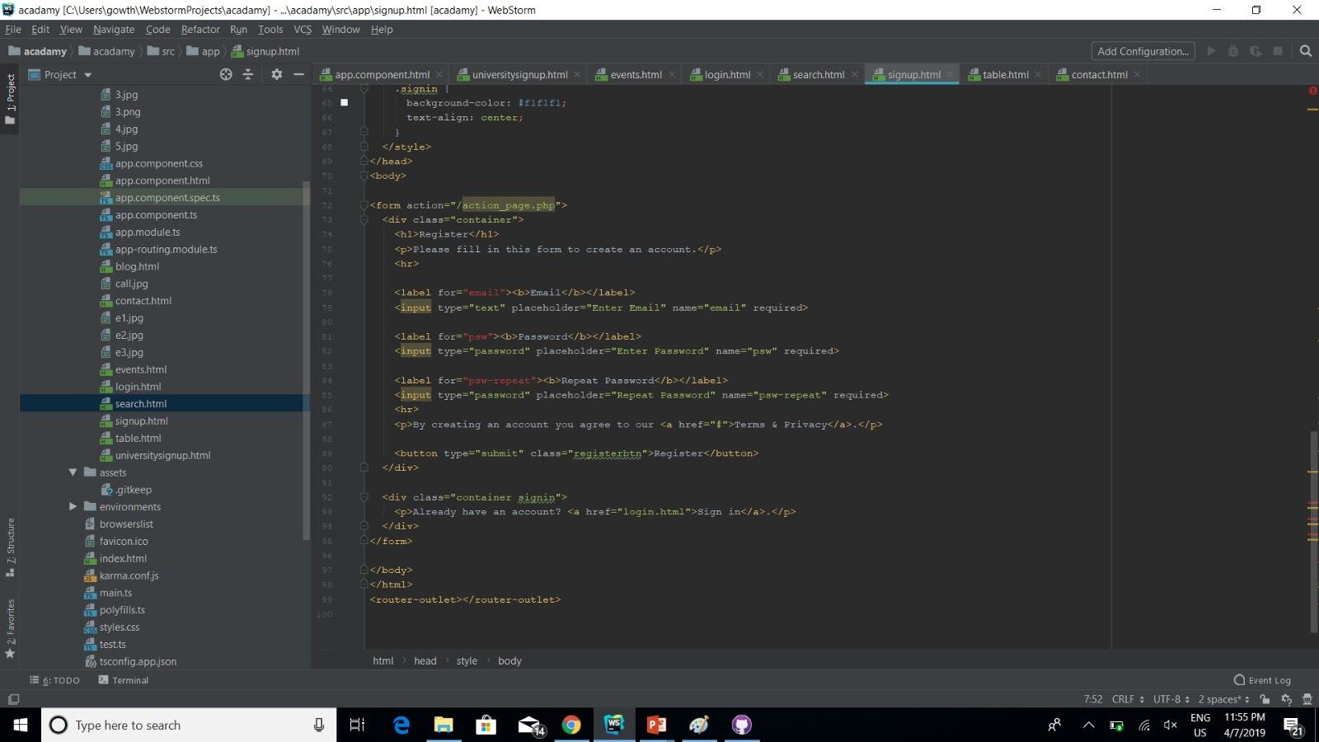
Code for registration page

Slide 10
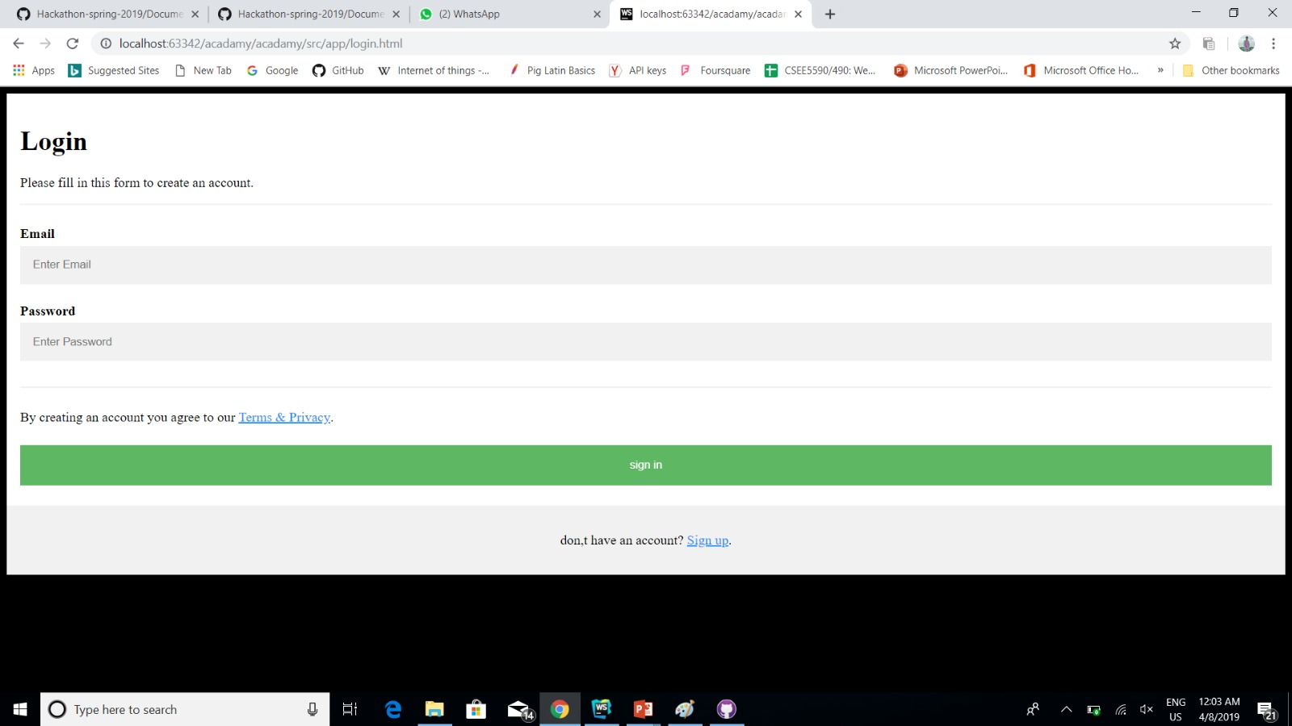
Login page

Slide 11
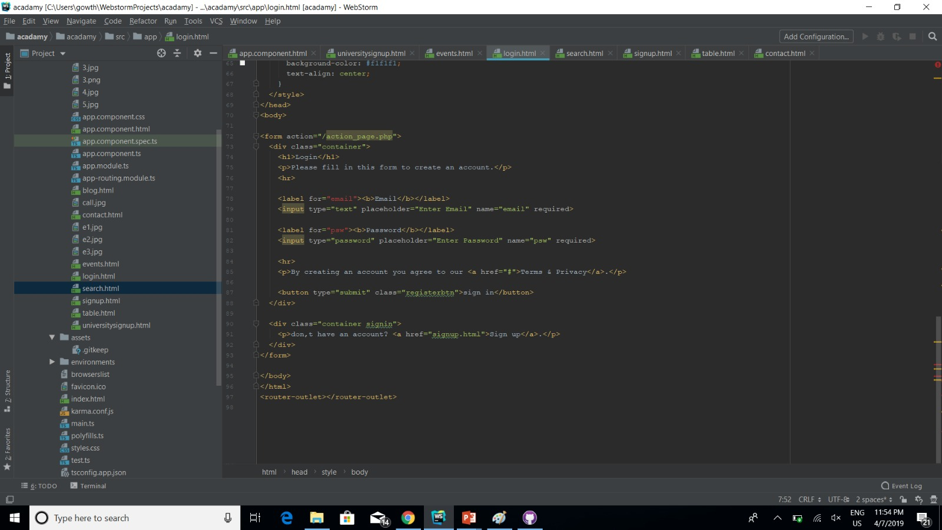
Code for login page

Slide 12

Thank You

